Slide 1
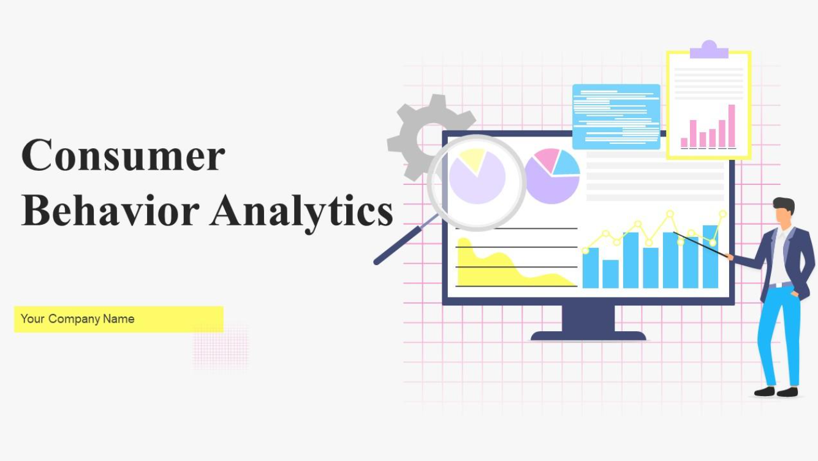
SQL PROJECT

Slide 2
Project Overview
This project involves analyzing customer transaction data to extract insights about customer behavior, product performance, and overall sales. The dataset covers electronic sales from Sep 2023 to Sep 2024.

Slide 3
Data Structure Overview
The Electronic Sales Database contains both numeric and categorical data, capturing essential customer and transaction details.
Customer ID: Unique identifier for each customer.
Age: Age of the customer (numeric)
Gender: Gender of the customer (Male or Female)
Loyalty Member: (Yes/No) (Values change by time, so pay attention to who cancelled and who signed up)
Product Type: Type of electronic product sold (e.g., Smartphone, Laptop, Tablet)

Slide 4
Data Structure Overview
SKU: a unique code for each product.
Rating: Customer rating of the product (1-5 stars) (Should have no Null Ratings)
Order Status: Status of the order (Completed, Cancelled)
Payment Method: Method used for payment (e.g., Cash, Credit Card, Paypal)
Total Price: Total price of the transaction (numeric)
Unit Price: Price per unit of the product (numeric)
Quantity: Number of units purchased (numeric)
Purchase Date: Date of the purchase (format: YYYY-MM-DD)
Shipping Type: Type of shipping chosen (e.g., Standard, Overnight, Express)
Add-ons Purchased: List of any additional items purchased (e.g., Accessories, Extended Warranty)
Add-on Total: Total price of add-ons purchased (numeric)

Slide 5
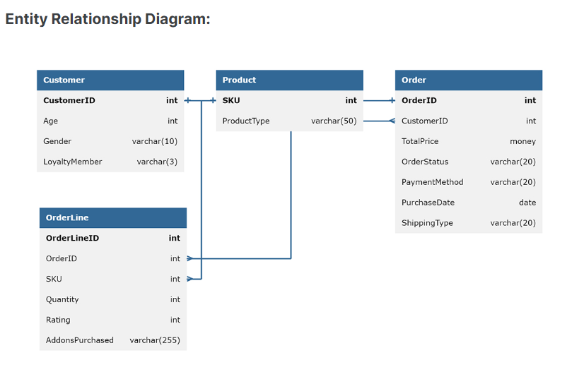
Entity Relationship Diagram

Slide 6
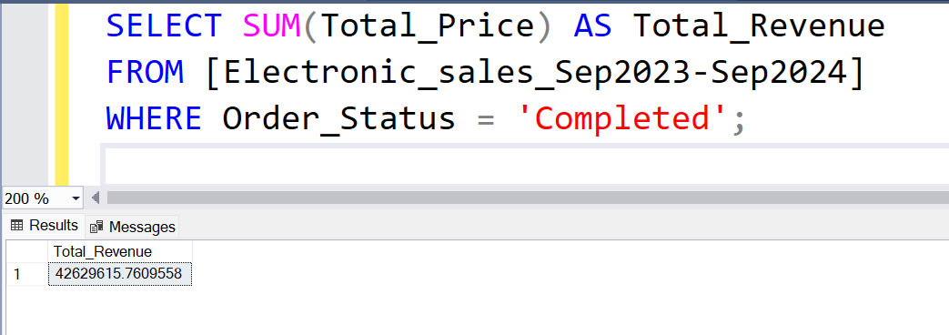
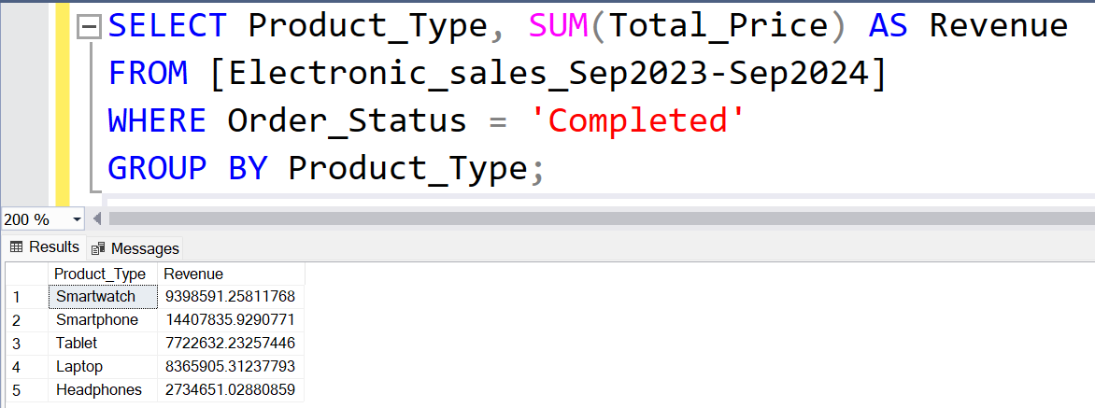
Sales Performance
Total Revenue Generated from Completed Sales
Revenue by Product

Slide 7
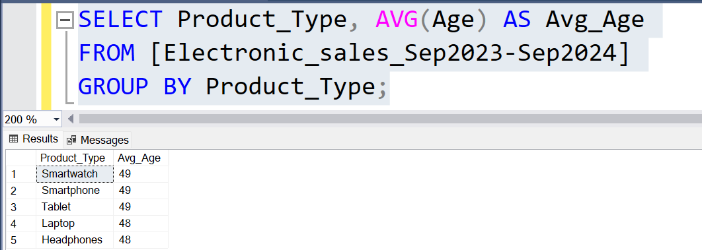
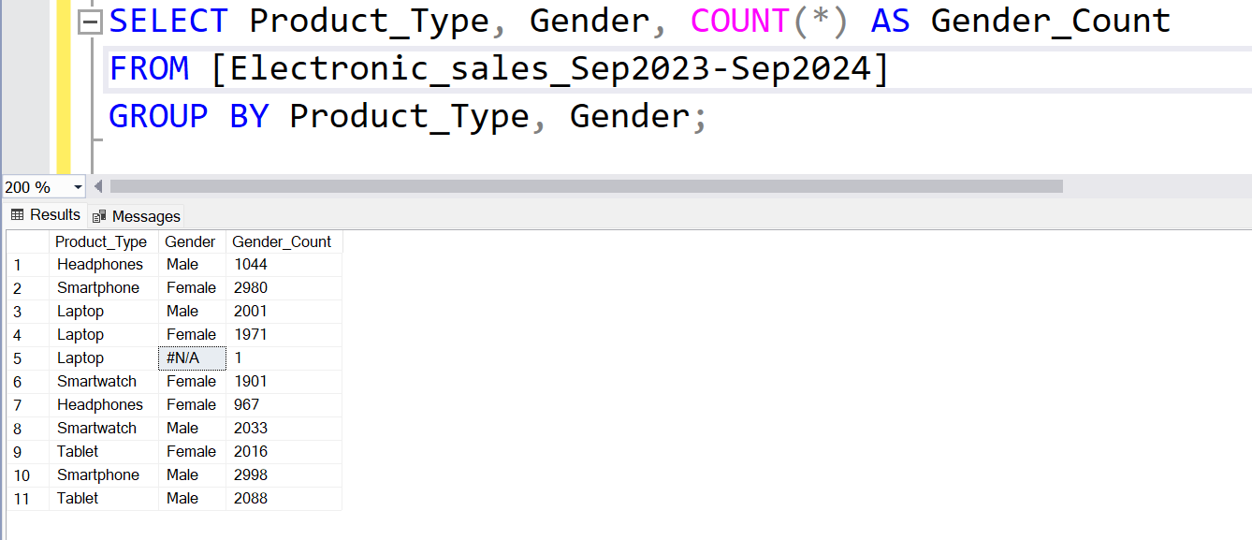
Customer Demographics
Average Age of Customers for Each Product
Gender Distribution Among Purchasers

Slide 8
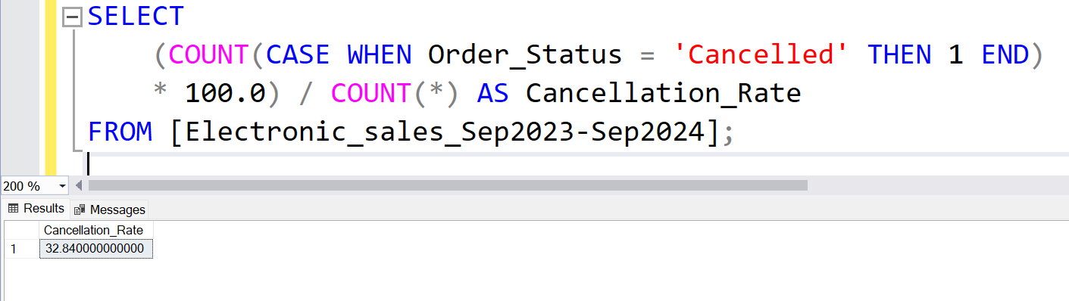
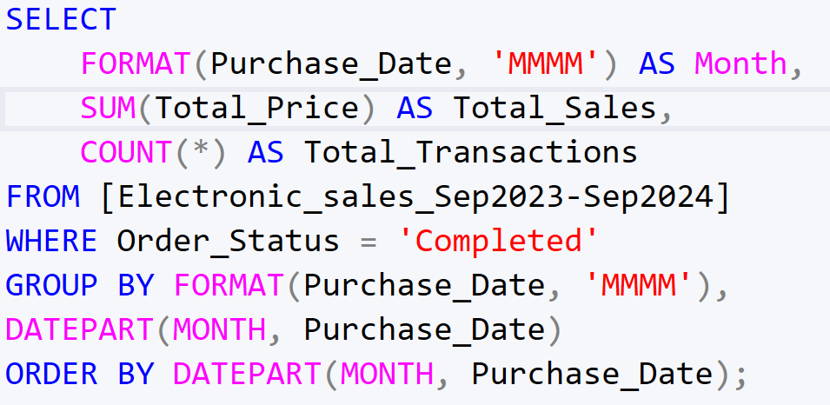
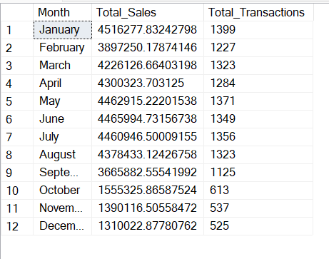
Order Status Analysis
Cancellation Rate for Purchases
Orders Placed by Month for completed order status

Slide 9
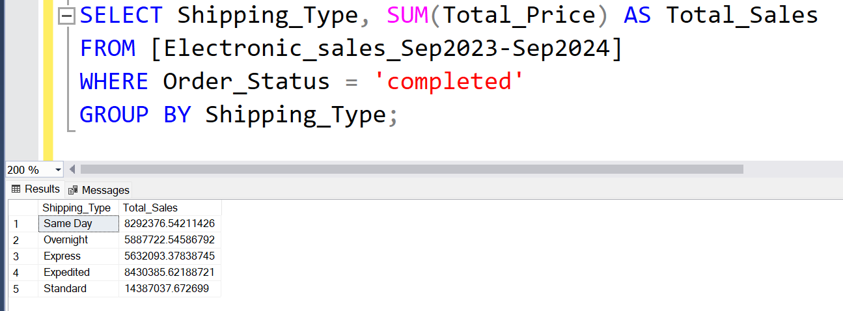
Shipping Insights
How Shipping Type Impacts Total Sales

Slide 10
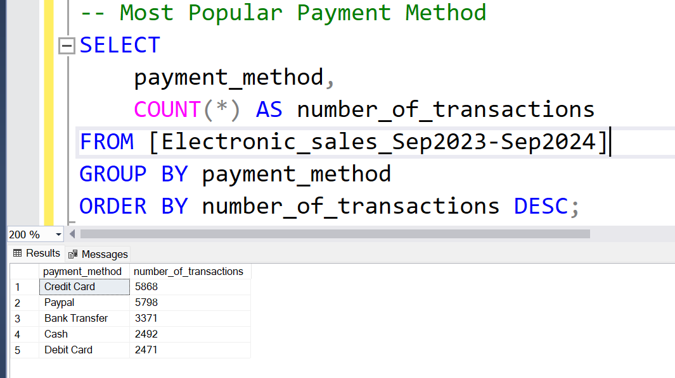
Popular Payment Method

Slide 11
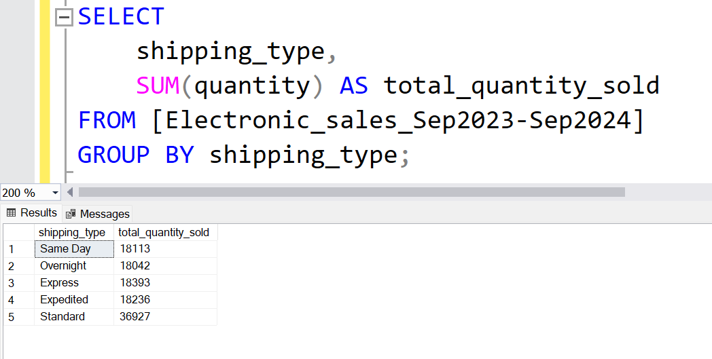
Total Quantity of Products Sold by Shipping Type

Slide 12
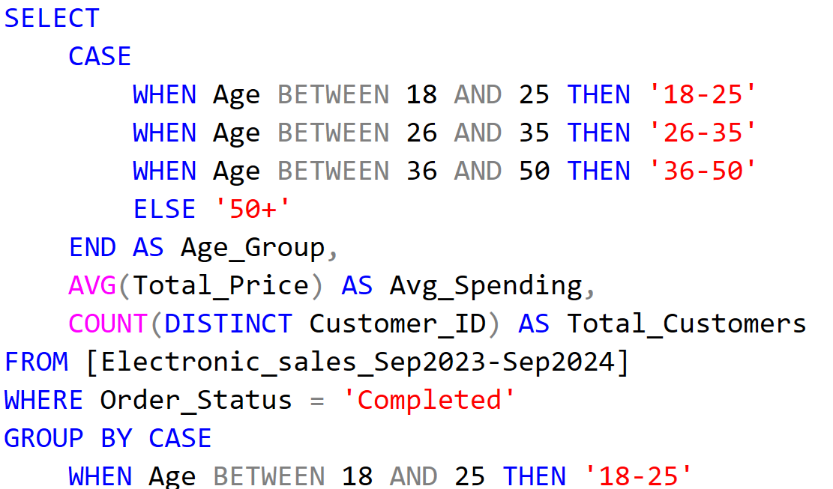
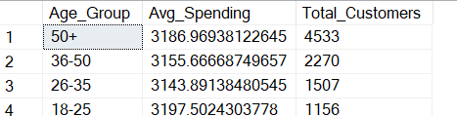
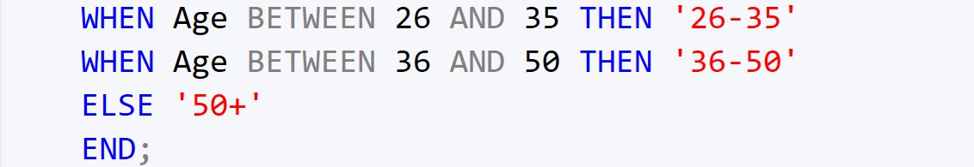
Loyalty Customer Demographics Analysis (Age Distribution)

Slide 13
Thank You

